Slide 1
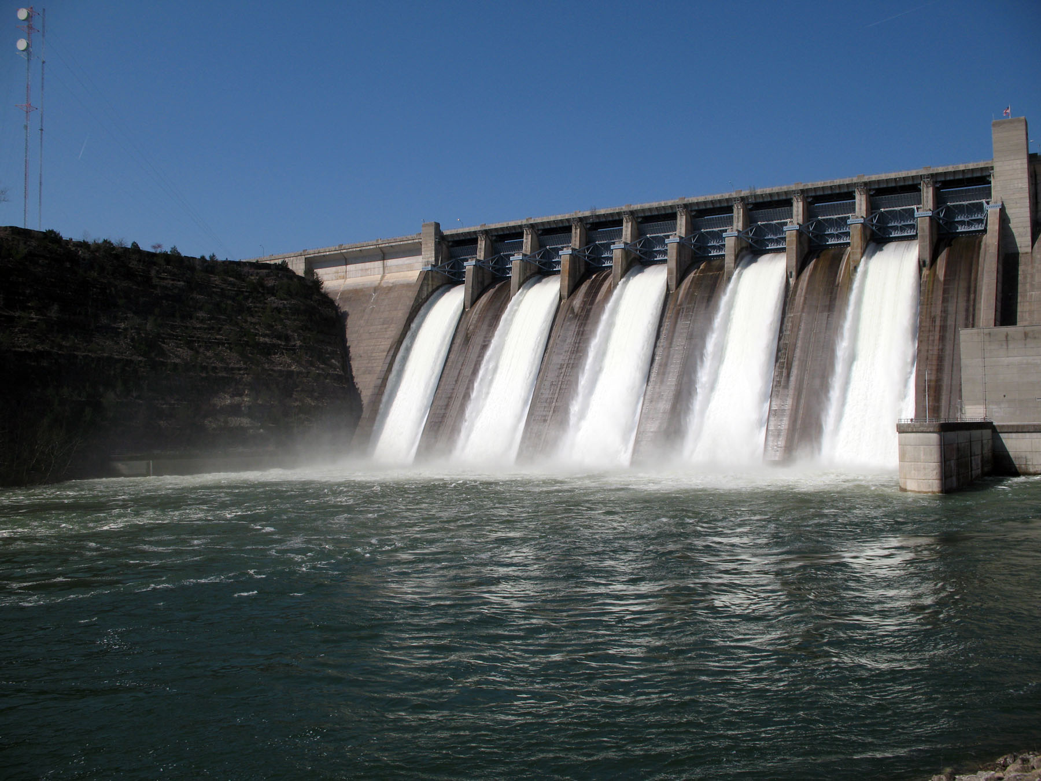
CASE STUDY: OPTIMIZATION OF SE ASIA LARGEST hydroelectric dam, Batang ai (SARAWAK)
Bernard tang tze wan

Slide 2
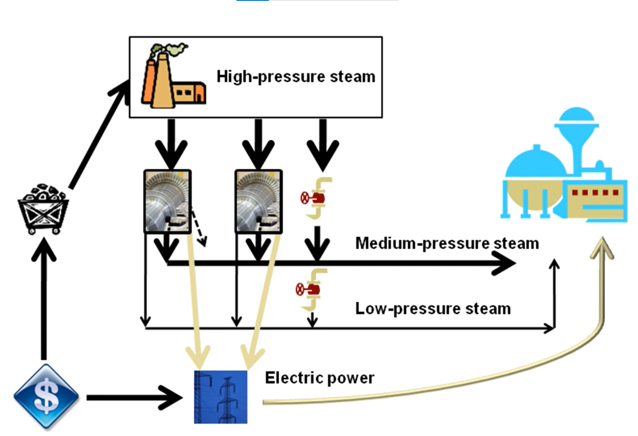
Mathematical modeling

Slide 3
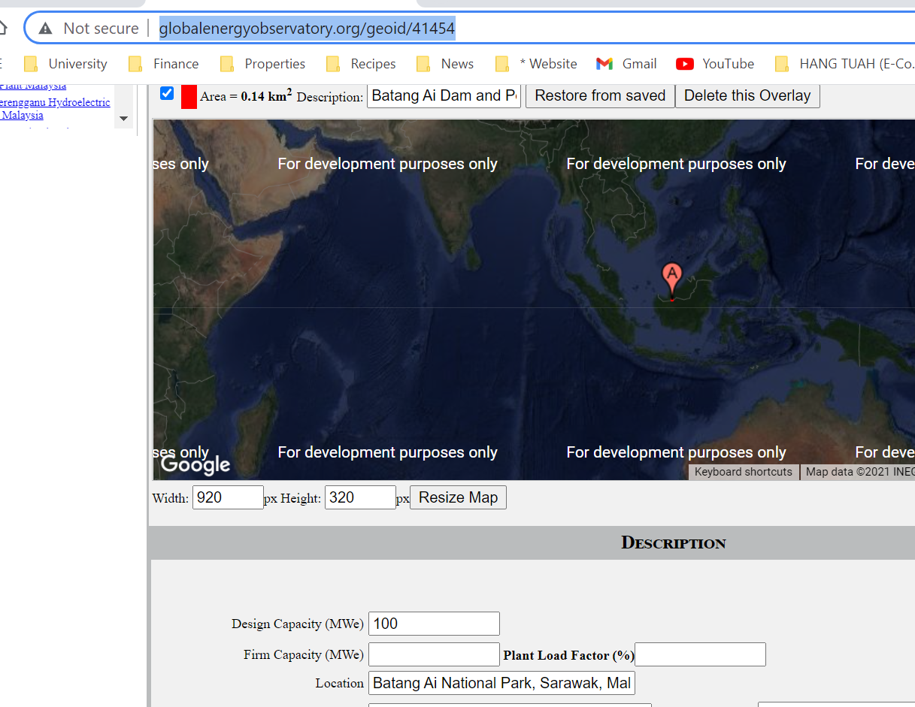
Batang Ai Dam INTRODUCTION
Batang Ai Dam is a concrete-face rock-fill dam in Batang Ai National Park in Sarawak, Malaysia. The power station comprises four 25 MW turbines, totalling the installed capacity to 100 MW.. Preparations for the dam began as early as 1975, before the design was published in 1977. Construction started in 1982 with the river diversion work and the last turbine completed in 1985

Slide 4
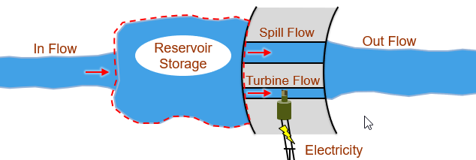
BATANG AI OPERATION FLOWCHARTART
CONSTRAINTS
0 < Turbine Flow < 25,000 Cubic Feet-per-Second (CFS)
0 < Spill Flow
Max change in Turbine and Spill Flow < 500 CFS
Combined Turbine and Spill Flow > 500 CFS
50000 < Reservoir Storage < 100000 Acre-Feet (AF)
Final reservoir level must equal
the initial level (90000 AF)

Slide 5
PROJECT objective
Optimizing turbine flow and spill rate over the time horizon, as defined by the data.
Define optimization variables with their bounds
turbineFlow = optimvar("turbineFlow",N,"LowerBound",0,"UpperBound",turbineFlowUpperBound);
spillFlow = optimvar("spillFlow",N,"LowerBound",0);
storage = optimvar("storage",N,"LowerBound",storageLowerBound,"UpperBound",storageUpperBound);
Define linear inequality constraints
Define total outflow as an optimization expression to use in defining the constraints.
outFlow = turbineFlow + spillFlow;
Constrain minimum outflow
p.Constraints.flowMin = outFlow >= outFlowLowerBound;
Limit change in outflow from one period to the next
p.Constraints.flowChangeDecreaseLimit = outFlow(1:N-1) - outFlow(2:N) <= outFlowChangeBound;
p.Constraints.flowChangeIncreaseLimit = outFlow(2:N) - outFlow(1:N-1) <= outFlowChangeBound;
Account for change in storage in each period
p.Constraints.storageBalance = optimconstr(N);

Slide 6
METHODOLOGY
Define objective function
Evaluate default solution
Optimize

Slide 7
MATLAB result USING QUADRATIC PROGRAMMING method
options = optimoptions(p','Display','iter');
[xOptimal,totalRevenue] = solve(p,"Options",options)
Solving problem using quadprog.
Your Hessian is not symmetric. Resetting H=(H+H')/2.
Solved 1 variables, 1 equality, and 0 inequality constraints during the presolve.
Iter Fval Primal Infeas Dual Infeas Complementarity
0 -2.397180e+01 4.008727e+04 1.196980e+05 9.487084e+01
1 7.821238e+03 1.415482e+04 4.226536e+04 6.575620e+01
2 -1.018528e+04 2.723199e+02 8.131293e+02 2.585829e+01
Minimum found that satisfies the constraints.

Slide 8
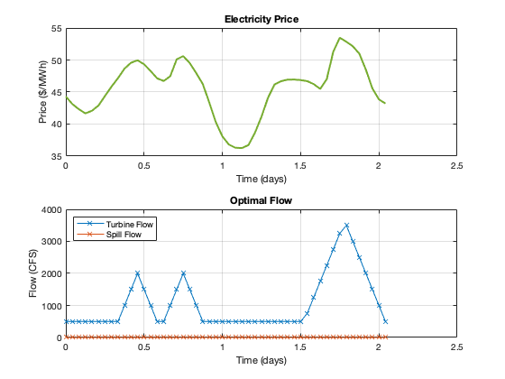
VISUALIZATION

